Slide 1
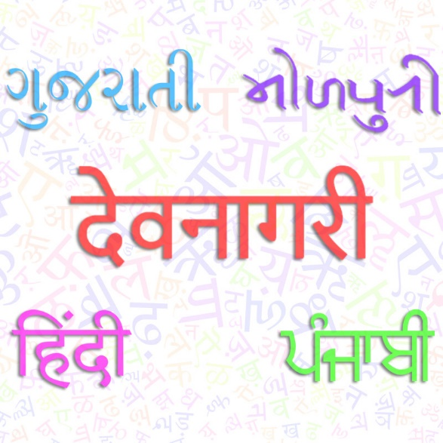
Named Entity Recognition for Low-Resource Languages
Sagunesh Grover
Roshandeep Singh Saini
Parth Chotai
Anurag Sharma

Slide 2
PROBLEM STATEMENT
One of the biggest open problems in the field of Computational Linguistics is the processing of Low Resource Languages. There are approximately 7000 languages in the world, of these only a small fraction (20 languages) are considered “high-resource” (like English). The majority of human languages are in dire need of tools and resources to overcome the resource barrier such that NLP can deliver more widespread benefits. They are called low-resource language
The aim of this project is to utilize transfer learning to fine tune a cross lingual model from a resource-rich language (Hindi) to morphologically and semantically similar languages with no/low annotated resources (Punjabi and Gujarati) for the sophisticated task of Named Entity Recognition (NER), hopefully outperforming the state-of-the-art baseline models.

Slide 3
DATA ACQUISITION
Source: Pan et al., "Cross-lingual Name Tagging and Linking for 282 Languages", ACL 2017.
We aim to use Hindi (Source), Punjabi and Gujarati (Target) annotated datasets because all these languages are derived from the Devanagari Script.
The Wiki Ann dataset itself is in .BIO format, from which the “words” would be extracted to be used as the corpus. The manually reviewed English translations for tokens (from Wikipedia.org) are also available alongside the Devanagari lexicon.
Hindi - कनाडा GPE 0.999996263783 Canada B-LOC
Gujarati - કેનેડામાં GPE 0.999996263783 Canada B-LOC
Punjabi - ਕੈਨੇਡਾ GPE 0.999996263783 Canada B-LOC
For extracting features/independent variables, sequences are required. Using these “words”, sentences from various Wikipedia pages in the respective language were scraped.
The tagging set consists of the usual B/I-PER, B/I-LOC, B/I-ORG and O.

Slide 4
DATA Preparation
These sentences consisted of the first paragraph of a particular entity/word’s Wikipedia article and we selected the densest one-hot encoded sentence vector in-order to minimize manual annotation effort and extract better features.
All the irrelevant words, phrases, html-tags and characters were removed using various language regex and data was prepared in the below format
Hindi Sentence
sentence_index | word | tag
1 | कनाडा | B-LOC
1 | उत्तरी | B-LOC
1 | अमेरिका | I-LOC
1 | का | O
1 | एक | O
1 | देश | O
1 | है | O
1 | । | O
Punjabi Sentence
sentence_index | word | tag
1 | ਦਾਦਰ | B-LOC
1 | ਮਹਾਂਰਾਸ਼ਟਰ | O
1 | ਦਾ | O
1 | ਇੱਕ | O
1 | ਕਸਬਾ | O
1 | ਹੈ | O
1 | . | O
Gujarati Sentence
sentence_index | word | tag
1 | સૂર્ય | B-LOC
1 | આપણા | O
1 | સૂર્યમંડળના | O
1 | મધ્યમાં | O
1 | આવેલો | O
1 | એક | O
1 | તારો | O
1 | છે | O

Slide 5
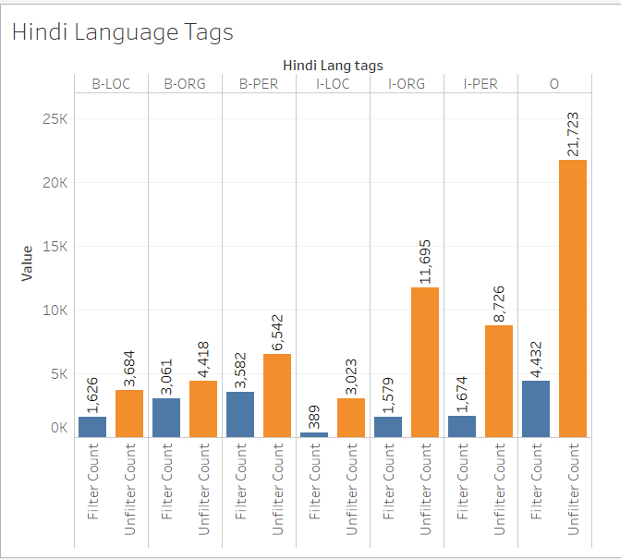
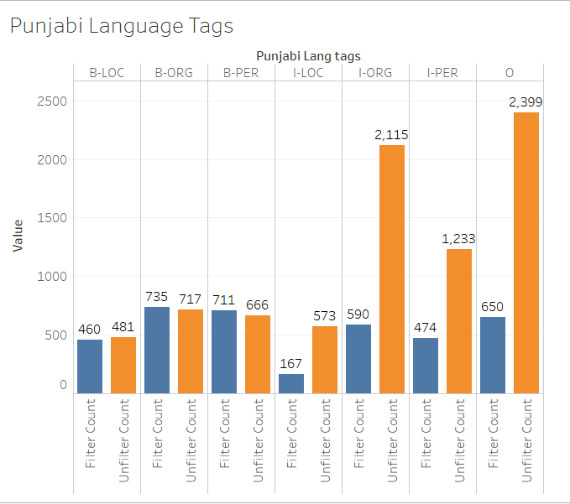
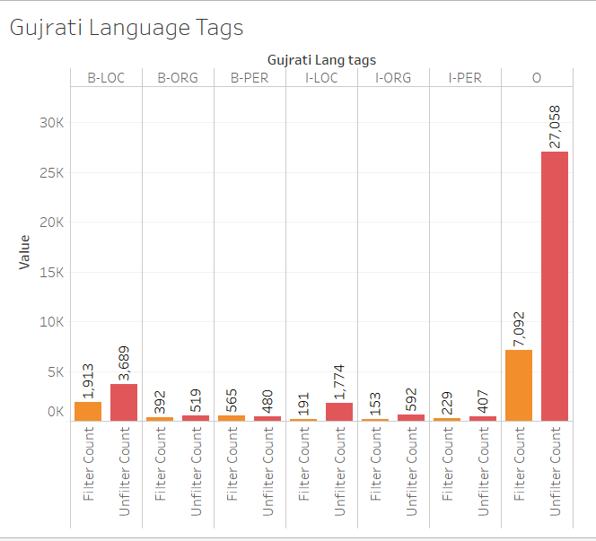
Exploratory data analysis
A distribution of length of sentences was drawn so that we could pad them.
Vocabularies of unique words (for every language) were generated, and a double vertical bar graph of BIO Tag vs unique words(filtered) & words(unfiltered) was plotted.

Slide 6
Feature engineering
Every word and its respective tag are mapped numerically for baseline language models
Tokenized each sentence with IndicBERT’s tokenizer to digest the sequence and add the special [CLS] and [SEP] BERT token to the beginning and ending of the sentence respectively (for the transfer learning model).
Used holdout validation and split each individual language set into Training Validation and Testing sets.
For transfer learning, the same was carried out for combined language set.

Slide 7
ML MODEL TRAINING
Baseline Model
BiLSTM (for Hindi, Punjabi and Gujarati each)
BiLSTM-CRF (for Hindi, Punjabi and Gujarati each)
Transfer Learning Model( One model for all Languages)
Multilingual BERT (Hindi, Punjabi and Gujarati Combined)

